Slide 1
BARC Remote HF

Slide 2
System Schematic – No Remote HF
SteppIR
40/80m EFHW
Rotator
Pwr/Signals
Feed Line
Feed Line
Yeasu
G-800DXA
SDA100
CI-V
Freq Info
ANT
SW
IC7300

Slide 3
System Schematic – With Remote HF
SteppIR
40/80m EFHW
Rotator
Pwr/Signals
Feed Line
Yeasu
G-800DXA
SDA100
Feed Line
Data In
Data Out
Rot Ext Ctrl
Home PC
Internet
Remote HF
CI-V
Freq Info
USB
Feed Line
IC7300

Slide 4
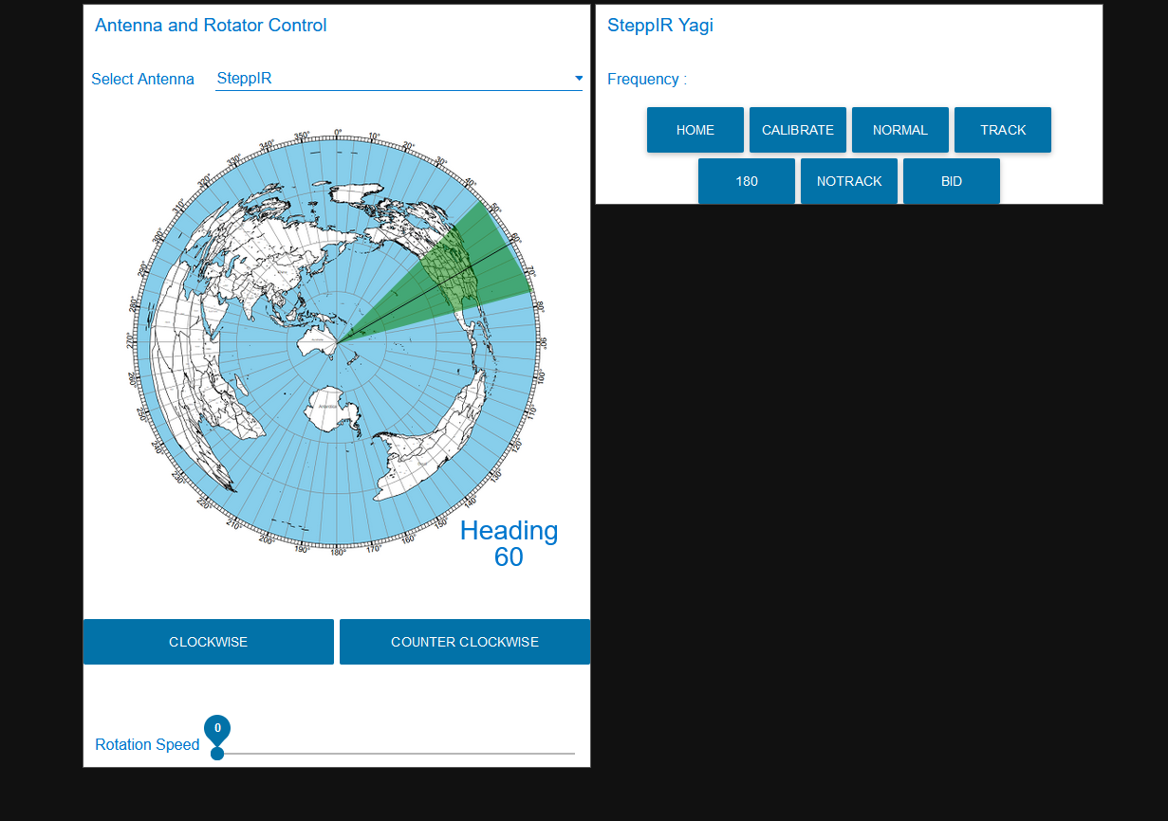
Home PC – Antenna/Rotator Control
Control the SteppIR
Select Antenna
Current Antenna Heading
Rotate the Antenna
CW/CCW
Control the speed of rotation

Slide 5
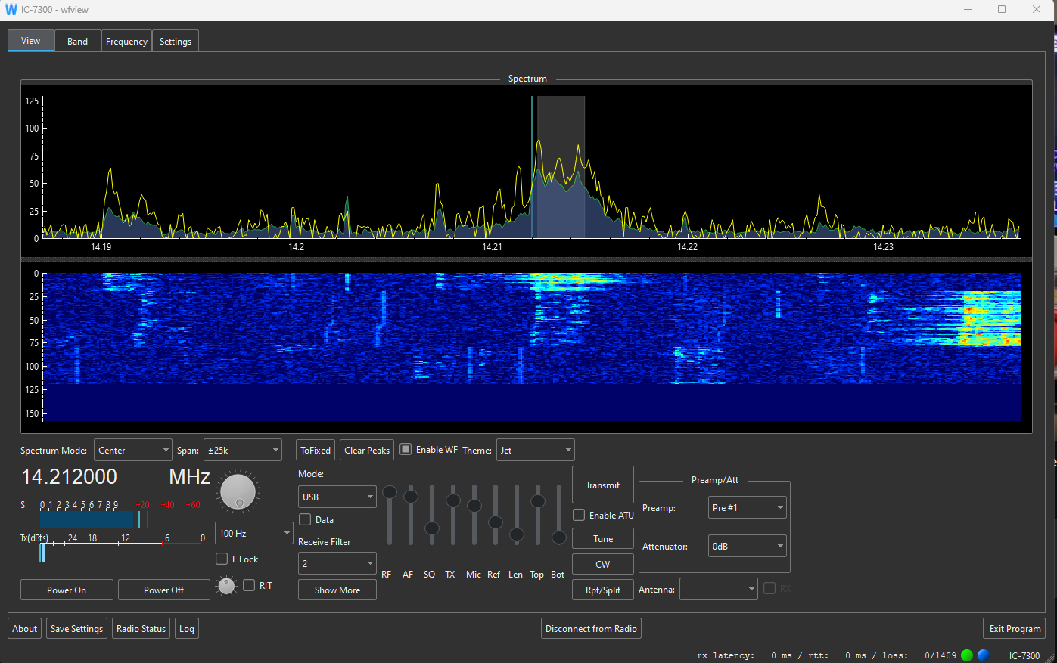
Home PC – WFView
Frequency Graph
Waterfall
PTT
Frequency/S Meter/
Radio settings
Soft power on/off the radio

Slide 6
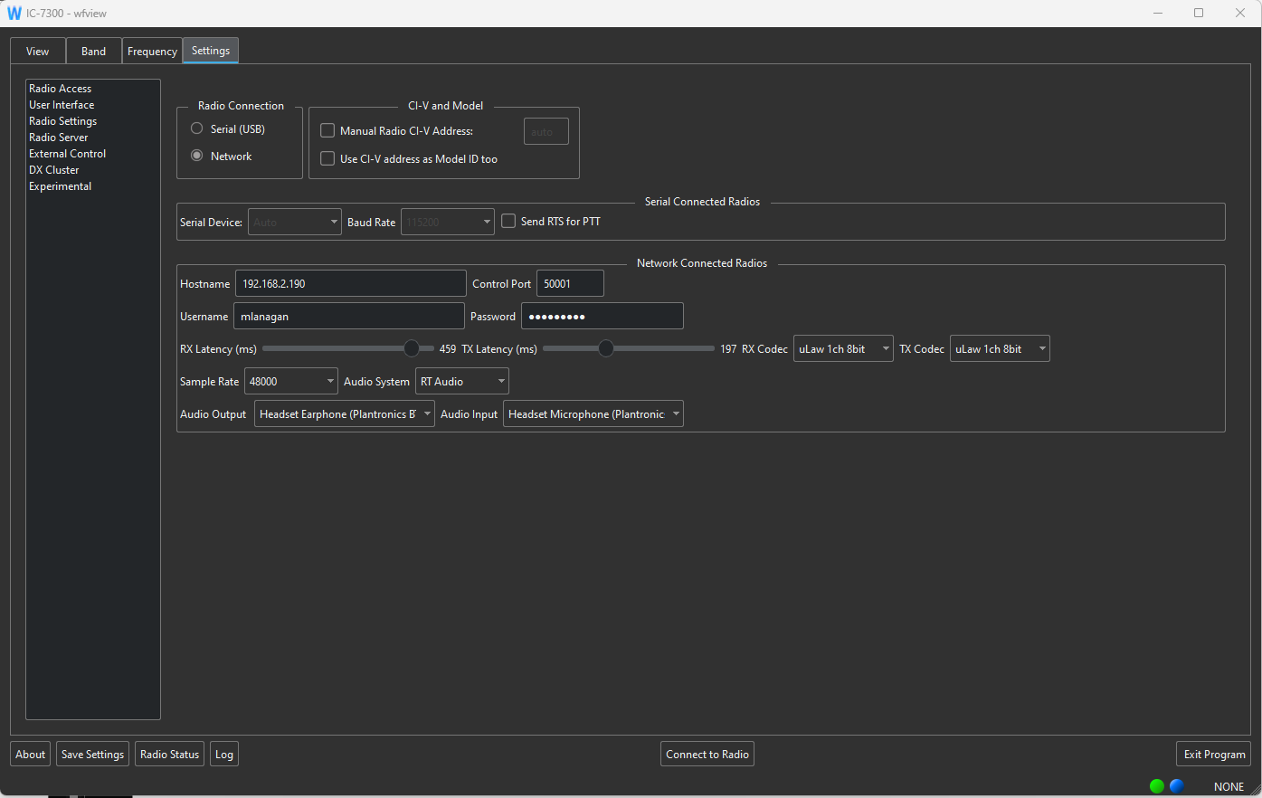
Permissions

Slide 7
VPN

